Slide 1
6
Information Systems within the Organization

Slide 2
Transaction Processing Systems
Functional Area Information Systems
Enterprise Resource Planning (ERP) Systems
ERP Support for Business Processes

Slide 3
Explain the purpose of transaction processing systems.
Explain the types of support that information systems can provide for each functional area of the organization.
Identify advantages and drawbacks to businesses implementing an enterprise resource planning system.

Slide 4
Describe the three main business processes supported by ERP systems.

Slide 5

The Lion King Roars Back
Why are yield management systems so important to the producers of Broadway shows? Hint: What is the value of an unsold seat once the curtain goes up?
Describe potential disadvantages of Disney’s yield management system.

Slide 6
Transaction Processing Systems
Transaction
Transaction Processing System (TPS)
Batch Processing
Online Transaction Processing (OLTP)
Notes:
Transaction: any business event that generates data worthy of being captured and stored in a database (e.g., product manufactured, a service sold, a person hired, and a payroll check generated)
Transaction Processing System (TPS): supports the monitoring, collection, storage, and processing of data from the organization’s basic business transactions, each of which generates and collects data continuously, in real time.
Source Data Automation: a process in which organizations try to automate the TPS data entry as much as possible because of the large volume involved.
Batch Processing: the firm collects data from transactions as they occur, placing them in groups or batches then prepares and processes the batches periodically.
Online Transaction Processing (OLTP): business transactions are processed online as soon as they occur and system performs these tasks in real time by means of online technologies.

Slide 7
Transaction Processing Systems
Transaction: any business event that generates data worthy of being captured and stored in a database (e.g., product manufactured, a service sold, a person hired, and a payroll check generated)
Transaction Processing System (TPS): supports the monitoring, collection, storage, and processing of data from the organization’s basic business transactions, each of which generates and collects data continuously, in real time.
Source Data Automation: a process in which organizations try to automate the TPS data entry as much as possible because of the large volume involved.
Notes:
Transaction: any business event that generates data worthy of being captured and stored in a database (e.g., product manufactured, a service sold, a person hired, and a payroll check generated)
Transaction Processing System (TPS): supports the monitoring, collection, storage, and processing of data from the organization’s basic business transactions, each of which generates and collects data continuously, in real time.
Source Data Automation: a process in which organizations try to automate the TPS data entry as much as possible because of the large volume involved.
Batch Processing: the firm collects data from transactions as they occur, placing them in groups or batches then prepares and processes the batches periodically.
Online Transaction Processing (OLTP): business transactions are processed online as soon as they occur and system performs these tasks in real time by means of online technologies.

Slide 8
Transaction Processing Systems
Batch Processing: the firm collects data from transactions as they occur, placing them in groups or batches then prepares and processes the batches periodically.
Online Transaction Processing (OLTP): business transactions are processed online as soon as they occur and system performs these tasks in real time by means of online technologies.
Notes:
Transaction: any business event that generates data worthy of being captured and stored in a database (e.g., product manufactured, a service sold, a person hired, and a payroll check generated)
Transaction Processing System (TPS): supports the monitoring, collection, storage, and processing of data from the organization’s basic business transactions, each of which generates and collects data continuously, in real time.
Source Data Automation: a process in which organizations try to automate the TPS data entry as much as possible because of the large volume involved.
Batch Processing: the firm collects data from transactions as they occur, placing them in groups or batches then prepares and processes the batches periodically.
Online Transaction Processing (OLTP): business transactions are processed online as soon as they occur and system performs these tasks in real time by means of online technologies.

Slide 9
Transaction Processing Systems
TPSs are inputs for the functional area information systems and business intelligence systems, as well as business operations such as customer relationship management, knowledge management, and e-commerce.
TPSs have to efficiently handle both high volumes of data and large variations in those volumes
they must avoid errors and downtime, record results accurately and securely, and maintain privacy and security

Slide 10
TPSs manage the complexities of transactional data
When more than one person or application program can access the database at the same time, the database has to be protected from errors resulting from overlapping updates.
When processing a transaction involves more than one computer, the database and all users must be protected against inconsistencies arising from a failure of any component at any time.
It must be possible to reverse a transaction in its entirety if it turns out to have been entered in error. It is also necessary to reverse a transaction when a purchased item is returned.

Slide 11
TPSs manage the complexities of transactional data
•When more than one person or application program can access the database at the same time, the database has to be protected from errors resulting from overlapping updates. The most common error is losing the results of one of the updates.
• When processing a transaction involves more than one computer, the database and all users must be protected against inconsistencies arising from a failure of any component at any time.
• It must be possible to reverse a transaction in its entirety if it turns out to have been entered in error. It is also necessary to reverse a transaction when a purchased item is returned.
• It is frequently important to preserve an audit trail. In fact, for certain transactions an audit trail may be legally required.

Slide 12
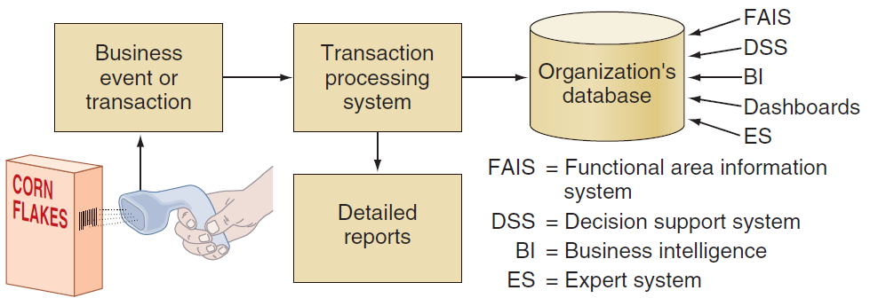
How TPS Manage Data?

Slide 13
Functional Area Information Systems
IS for Accounting and Finance
IS for Marketing
IS for Production/Operations Management
IS for Human Resource Management
Reports
Notes:
Information Systems for Marketing: Any successful organization must understand its customers’ needs and wants and then develop its marketing and advertising strategies around them.

Slide 14
IS for Accounting and Finance
Financial Planning and Budgeting
Managing Financial Transactions
Investment Management
Control and Auditing
Notes:
Financial Planning and Budgeting: Appropriate management of financial assets and is an important part of managerial planning for both acquiring and utilizing resources.
Managing Financial Transactions: accounting/finance software packages that are integrated with other functional areas (e.g., Peachtree offers a sales ledger, a purchase ledger, a cash book, sales order processing, invoicing, stock control, a fixed assets register, etc.). Organizations, business processes, and business activities operate with, and manage, financial transactions.
Investment Management: Systems for managing organization investments in in stocks, bonds, real estate, and other assets that are subject to complex regulations and tax laws, which vary from one location to another.
Control and Auditing: effectively control their finances and financial statements. Let us examine some of the most common forms of financial control.

Slide 15
IS for Accounting and Finance
Financial Planning and Budgeting:Appropriate management of financial assets and is an important part of managerial planning for both acquiring and utilizing resources.
Managing Financial Transactions:accounting/finance software packages that are integrated with other functional areas (e.g., Peachtree offers a sales ledger, a purchase ledger, a cash book, sales order processing, invoicing, stock control, a fixed assets register, etc.). Organizations, business processes, and business activities operate with, and manage, financial transactions.
Investment Management:Systems for managing organization investments in in stocks, bonds, real estate, and other assets that are subject to complex regulations and tax laws, which vary from one location to another.
Control and Auditing:effectively control their finances and financial statements.
Notes:
Financial Planning and Budgeting: Appropriate management of financial assets and is an important part of managerial planning for both acquiring and utilizing resources.
Managing Financial Transactions: accounting/finance software packages that are integrated with other functional areas (e.g., Peachtree offers a sales ledger, a purchase ledger, a cash book, sales order processing, invoicing, stock control, a fixed assets register, etc.). Organizations, business processes, and business activities operate with, and manage, financial transactions.
Investment Management: Systems for managing organization investments in in stocks, bonds, real estate, and other assets that are subject to complex regulations and tax laws, which vary from one location to another.
Control and Auditing: effectively control their finances and financial statements. Let us examine some of the most common forms of financial control.

Slide 16
Financial Planning and Budgeting
Appropriate management of financial assets and is an important part of managerial planning for both acquiring and utilizing resources.
Financial and economic forecasting:Knowledge about the availability and cost of money a key ingredient for successful financial planning including flow projections which inform organizations what funds they need, when they need them, and how they will acquire them.
Budgeting:allocates the organization’s financial resources among participants and activities allowing management to distribute resources in the way that best supports the organization’s mission and goals.
Notes:
Financial Planning and Budgeting: Appropriate management of financial assets and is an important part of managerial planning for both acquiring and utilizing resources.
Financial and Economic Forecasting: Knowledge about the availability and cost of money a key ingredient for successful financial planning including flow projections which inform organizations what funds they need, when they need them, and how they will acquire them.
Budgeting: allocates the organization’s financial resources among participants and activities allowing management to distribute resources in the way that best supports the organization’s mission and goals.

Slide 17
Managing Financial Transactions
Accounting/finance software packages that are integrated with other functional areas (e.g A purchase ledger, a cash book, sales order processing, invoicing, stock control, a fixed assets register, etc.). Organizations, business processes, and business activities operate with, and manage, financial transactions.
Global stock exchanges(Financial markets operate in global, 24/7/365)
Managing multiple currencies
Virtual close
Expense management automation (EMA)
Notes:
Managing Financial Transactions: accounting/finance software packages that are integrated with other functional areas (e.g., Peachtree offers a sales ledger, a purchase ledger, a cash book, sales order processing, invoicing, stock control, a fixed assets register, etc.). Organizations, business processes, and business activities operate with, and manage, financial transactions.
Global stock exchanges: Financial markets operate in global, 24/7/365, distributed electronic stock exchanges that use the Internet both to buy and sell stocks and to broadcast real-time stock prices
Managing multiple currencies: Financial and accounting systems utilize financial data from different countries to convert currencies (with conversion ratios that constantly flux) in seconds.
Virtual close: the ability the books quickly at any time, on very short notice (rather than quarterly) which provides almost real-time information on the organization’s financial health.
Expense management automation (EMA): systems that automate the data entry and processing of travel and entertainment expenses through Web-based applications that enable companies to quickly and consistently collect expense information, enforce company policies and contracts, and reduce unplanned purchases as well as airline and hotel expenses.

Slide 18
Managing Financial Transactions
Global stock exchanges:Financial markets operate in global, 24/7/365, distributed electronic stock exchanges that use the Internet both to buy and sell stocks and to broadcast real-time stock prices
Managing multiple currencies:Financial and accounting systems utilize financial data from different countries to convert currencies (with conversion ratios that constantly flux) in seconds.
Expense management automation (EMA): systems that automate the data entry and processing of travel and entertainment expenses through Web-based applications that enable companies to quickly and consistently collect expense information, enforce company policies and contracts, and reduce unplanned purchases as well as airline and hotel expenses.

Slide 19
Investment Management
Systems for managing organization investments in stocks, bonds, real estate, and other assets that are subject to complex regulations and tax laws, which vary from one location to another.

Slide 20
Control and Auditing
effectively control their finances and financial statements.
Budgetary control: managers at various levels monitor departmental expenditures and compare them against the budget and the operational progress of corporate plans.
Auditing:monitoring how the organization’s monies are being spent and assessing the organization’s financial health.
Financial ratio analysis:monitoring the company’s financial health by assessing a set of financial ratios.
liquidity ratios :the availability of cash to pay debt
activity ratios: how quickly a firm converts noncash assets to cash assets
debt ratios: measure the firm’s ability to repay long-term debt
profitability ratios: measure the firm’s use of its assets and control of its expenses to generate an acceptable rate of return
Notes:
Control and Auditing: effectively control their finances and financial statements. Let us examine some of the most common forms of financial control.
Budgetary control: managers at various levels monitor departmental expenditures and compare them against the budget and the operational progress of corporate plans.
Auditing: monitoring how the organization’s monies are being spent and assessing the organization’s financial health.
Financial ratio analysis: monitoring the company’s financial health by assessing a set of fi nancial ratios including liquidity ratios (the availability of cash to pay debt), activity ratios (how quickly a firm converts noncash assets to cash assets), debt ratios (measure thefi rm’s ability to repay long-term debt), and profitability ratios (measure the fi rm’s use of its assets and control of its expenses to generate an acceptable rate of return).

Slide 21
IS for Marketing
Any successful organization must understand its customers’ needs and wants.
They develop its marketing and advertising strategies around them.
Information systems provide numerous types of support to the marketing function.

Slide 22
IS for Production/Operations Management (POM)
In-House Logistics and Materials Management
Logistics management deals with ordering, purchasing, inbound logistics (receiving), and outbound logistics (shipping) activities
Inventory Management
How much inventory an organization should maintain.
Both excessive inventory and insufficient inventory create problems.
Overstocking can be expensive, because of storage costs and the costs of spoilage and obsolescence.
Insufficient inventory is also expensive, because of last-minute orders and lost sales.
Quality Control:
Quality-control systems used by manufacturing units provide information about the quality of incoming material and parts, as well as the quality of in-process semi finished and finished products.
These systems record the results of all inspections and compare the actual results to established metrics

Slide 23
IS for Production/Operations Management (POM)
Planning Production and Operations Management
Material requirements planning (MRP)
Manufacturing resource planning (MRP II)
Enterprise resource planning (ERP)
Computer-Integrated Manufacturing (Goals)
To simplify all manufacturing technologies and techniques
To automate as many of the manufacturing processes as possible
To integrate and coordinate all aspects of design, manufacturing, and related functions via computer systems.
Product Lifecycle Management
Product life cycle management is a business strategy that enables manufacturers to share product-related data that support product design and development and supply chain operations.

Slide 24
IS for Human Resource Management
Recruitment
Human Resources Development
Human Resources Planning and Management
Three Areas of IT support in HR Planning and Management
Payroll and employees’ records
Benefits administration
Employee relationship management
Notes:
Recruitment: systems that assist human resource personnel in finding potential employees, evaluating them, and deciding which ones to hire.
Human Resources Development: IS that assist human resource personnel in helping new hires become part of the corporate human resources pool through evaluation and development.
Human Resources Planning and Management: Managing human resources in large organizations requires extensive planning and detailed strategy.

Slide 25
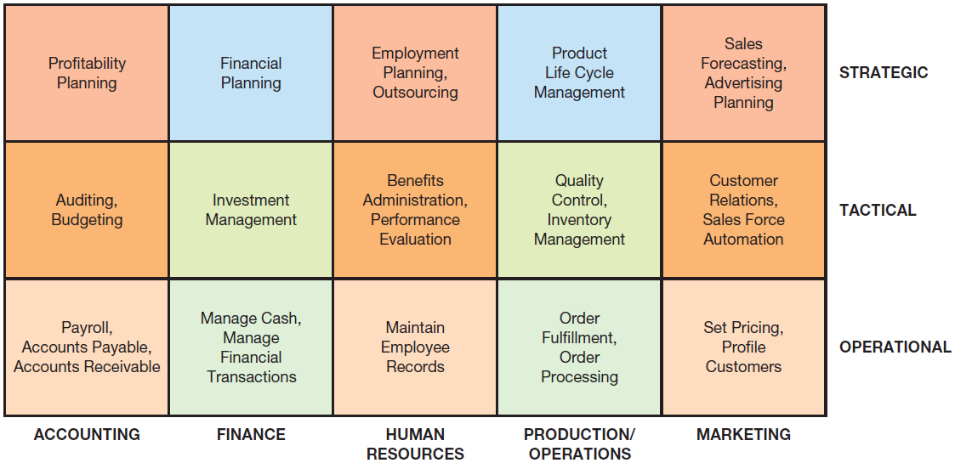
Systems supporting functional Areas

Slide 26
Reports
Routine Reports:reports produced at scheduled intervals.
Ad-hoc (On-Demand) Reports:out-of-the routine reports.
Drill-down reports:display a greater level of detail.
Key indicator reports: summarize the performance of critical activities.
Comparative reports: compare and contrast the performances of different business units or of a single unit during different time periods.
Exception reports:include only information that falls outside certain threshold standards.
Notes:
Routine Reports: reports produced at scheduled intervals.
Ad-hoc Reports: out-of-the routine reports.
Drill-Down Reports: display a greater level of detail.
Key Indicator Reports: summarize the performance of critical activities.
Comparative Reports: compare and contrast the performances of different business units or of a single unit during different time periods.
Exception Reports: include only information that falls outside certain threshold standards.

Slide 27
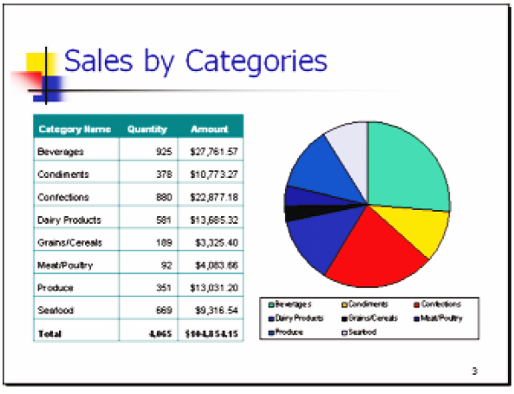
Monthly Sales Report

Slide 28
Enterprise Resource Planning (ERP) Systems
ERP Systems designed to correct a lack of communication among the functional area IS.
They adopt a business process view of the overall organization to integrate the planning, management, and use of all of an organization’s resources, employing a common software platform and database.
Notes:
Enterprise Resource Planning (ERP) Systems: systems designed to correct a lack of communication among the functional area IS and they adopt a business process view of the overall organization to integrate the planning, management, and use of all of an organization’s resources, employing a common software platform and database.
ERP II Systems: interorganizational ERP systems that provide Web-enabled links among a company’s key business systems—such as inventory and production—and its customers, suppliers, distributors, and other relevant parties.
Enterprise Application Integration (EAI) System: integrates existing systems by providing software, called middleware, that connects multiple applications allowing existing applications to communicate and share data.

Slide 29
Enterprise Resource Planning (ERP) Systems
ERP II Systems:
Interorganizational ERP systems that provide Web-enabled links among a company’s key business systems—such as inventory and production—and its customers, suppliers, distributors, and other relevant parties.
Enterprise Application Integration:
Integrates existing systems by providing software, called middleware, that connects multiple applications allowing existing applications to communicate and share data
Notes:
Enterprise Resource Planning (ERP) Systems: systems designed to correct a lack of communication among the functional area IS and they adopt a business process view of the overall organization to integrate the planning, management, and use of all of an organization’s resources, employing a common software platform and database.
ERP II Systems: interorganizational ERP systems that provide Web-enabled links among a company’s key business systems—such as inventory and production—and its customers, suppliers, distributors, and other relevant parties.
Enterprise Application Integration (EAI) System: integrates existing systems by providing software, called middleware, that connects multiple applications allowing existing applications to communicate and share data.

Slide 30
ERP II
SYSTEM
Core ERP Modules
Manufacturing
& Production
Module
Accounting and Financial Module
Human Resources Module
Suppliers
Customers
Supply Chain Management Module
ERP Platform & Database
Customer Relationship Management Module
Business
Intelligence
Module
E-Business Module
Extended ERP Modules

Slide 31
ERP Systems: Benefits
Organizational Flexibility and Agility: ERP systems break down many former departmental and functional silos of business processes, information systems, and information resources making organizations more flexible, agile, and adaptive.
Decision Support: provide essential information on business performance across functional areas which significantly improves managers’ ability to make better, more timely decisions.
Quality and Efficiency: ERP systems integrate and improve an organization’s business processes, generating significant improvements in the quality of production, distribution, and customer service.
Notes:
Organizational Flexibility and Agility: ERP systems break down many former departmental and functional silos of business processes, information systems, and information resources making organizations more flexible, agile, and adaptive.
Decision Support: provide essential information on business performance across functional areas which significantly improves managers’ ability to make better, more timely decisions.
Quality and Efficiency: ERP systems integrate and improve an organization’s business processes, generating signifi cant improvements in the quality of production, distribution, and customer service.

Slide 32
ERP Systems: Limitations
Business Processes Predefined by Best Practices: may require companies need to change their existing business processes to fit the predefined business processes incorporated into the ERP software.
Difficult to Implement: ERP systems can be extremely complex, expensive, and time consuming to implement.
Potential for Failure
Notes:
Business Processes Predefined by Best Practices: may require companies need to change their existing business processes to fit the predefined business processes incorporated into the ERP software.
Difficult to Implement: ERP systems can be extremely complex, expensive, and time consuming to implement.
Potential for Failure

Slide 33
Major Causes of ERP Implementation Failure
Failure to involve affected employees in planning and development
Attempting too much too fast
Insufficient training
Failure to perform proper data conversion and testing
Notes:
Major Causes of ERP Implementation Failure:
Failure to involve affected employees in the planning and development phases and in change management processes
Trying to accomplish too much too fast in the conversion process
Insufficient training in the new work tasks required by the ERP system
Failure to perform proper data conversion and testing for the new system

Slide 34
Implementing ERP Systems
On-Premise ERP Implementation
Software-as-a-Service (SaaS) ERP Implementation
Notes:
ERP Software-as-a-Service (SaaS): a cloud based solution in which the company rents the software from an ERP vendor who offers its products over the Internet, manages software updates, and is responsible for the system’s security and availability.

Slide 35
On-Premise ERP Implementation
Vanilla Approach
Custom Approach
Best of Breed Approach
Notes:
Vanilla Approach: a company implements a standard ERP package, using the package’s built-in configuration options.
Custom Approach: a company implements a more customized ERP system by developing new ERP functions designed specifically for that firm.
Best of Breed Approach: combines the benefits of the vanilla and customized systems while avoiding the extensive costs and risks associated with complete customization.

Slide 36
On-Premise ERP Implementation
Vanilla Approach: a company implements a standard ERP package, using the package’s built-in configuration options.
Custom Approach: a company implements a more customized ERP system by developing new ERP functions designed specifically for that firm.
Best of Breed Approach: combines the benefits of the vanilla and customized systems while avoiding the extensive costs and risks associated with complete customization.
Notes:
Vanilla Approach: a company implements a standard ERP package, using the package’s built-in configuration options.
Custom Approach: a company implements a more customized ERP system by developing new ERP functions designed specifically for that firm.
Best of Breed Approach: combines the benefits of the vanilla and customized systems while avoiding the extensive costs and risks associated with complete customization.

Slide 37
Vanilla Approach
In this approach, a company implements a standard ERP package,using the package’s built-in configuration options. When the system is implemented in this way, it will deviate only minimally from the package’s standardized settings.
The vanilla approach can make the implementation quicker, but the extent to which the software is adapted to the organization’s specifi c processes is limited.
Fortunately, a vanilla implementation provides general functions that can support the fi rm’s common business processes with relative ease, even if they are not a perfect fi t for those processes

Slide 38
Custom Approach
In this approach, a company implements a more customized ERP system by developing new ERP functions designed specifically for that firm.
Decisions concerning the ERP’s degree of customization are specific to each organization.
To utilize the custom approach, the organization must carefully analyze its existing business processes to develop a system that conforms to the organizations particular characteristics and processes.
In addition, customization is expensive and risky because computer code must be written and updated every time a new version of the ERP software is released.
Going further, if the customization does not perfectly match the organization’s needs, then the system can be
very diffi cult to use

Slide 39
The best of breed approach
This approach combines the benefits of the vanilla and customized systems while avoiding the extensive costs and risks associated with complete customization.
Companies that adopt this approach mix and match core ERP modules as well as other extended ERP modules from different software providers to best fit their unique internal processes and value chains.
Thus, a company may choose several core ERP modules from an established vendor to take advantage of industry best practices—for example, for fi nancial management and human resource management.
At the same time, it may also choose specialized software to support its unique business processes—for example, for manufacturing, warehousing and distribution.
Sometimes companies arrive at the best of breed approach the hard way.
For example, Dell wasted millions of dollars trying to customize an integrated ERP system from a major vendor to match its unique processes before it realized that a smaller, more flexible system that integrated well with other corporate applications was the answer.

Slide 40
Software-as-a-Service ERP Implementation.
Do not buy on premise ERP system.
Company rents the software from an ERP vendor who offers its products over the Internet using the SaaS model.
ERP cloud vendor manages software updates and is responsible for the system’s security and availability.
Cloud-based ERP systems can be a perfect fit for some companies. For instance, companies that cannot afford to make large investments in IT, yet which already have relatively structured business processes that need to be tightly integrated, might benefit from cloud computing.
The relationship between the company and the cloud vendor is regulated by contracts and by service level agreements (SLAs)

Slide 41
Software-as-a-Service ERP Implementation.
Companies can acquire ERP systems without having to buy a complete software solution (i.e., on-premise ERP implementation).
In this business model, the company rents the software from an ERP vendor who offers its products over the Internet using the SaaS model.
The ERP cloud vendor manages software updates and is responsible for the system’s security and availability.
Cloud-based ERP systems can be a perfect fi t for some companies. For instance, companies that cannot afford to make large investments in IT, yet which already have relatively structured business processes that need to be tightly integrated, might benefi t from cloud computing.
The relationship between the company and the cloud vendor is regulated by contracts and by service level agreements (SLAs)

Slide 42
Three major advantages of using a cloud-based ERP system are:
The system can be used from any location that provides Internet access. Consequently, users can work from any location using online shared and centralized resources (data and databases).
Companies using cloud-based ERP avoid the initial hardware and software expenses that are typical of on-premise implementations
Cloud-based ERP solutions are scalable, meaning it is possible to extend ERP support to new business processes and new business partners (e.g., suppliers) by purchasing new ERP modules.

Slide 43
Three major advantages of using a cloud-based ERP system are:
The system can be used from any location that provides Internet access
Initial hardware and software expenses that are typical of on premise implementations
Cloud-based ERP solutions are scalable

Slide 44
Three main disadvantages of using a cloud-based ERP system are:
It is not clear whether cloud-based ERP systems are more secure than on-premise systems.
In fact, a 2012 survey conducted by North Bridge Venture Partners indicated that security
was the primary reason why organizations did not adopt cloud-based ERP

Slide 45
Main disadvantages of using a cloud-based ERP system are:
Security
In fact, a 2012 survey conducted by North Bridge Venture Partners indicated that security was the primary reason why organizations did not adopt cloud-based ERP

Slide 46
’S ABOUT BUSINESS 11.1
GEA Group Uses SAP for Financial Reporting
Discuss the reasons why financial reports must be timely.
Explain how SAP enabled the GEA Group to produce their financial reports in an efficient, timely manner.
What are the advantages of the SAP solution to the GEA Group?

Slide 47
ERP Support for Business Processes
The Procurement, Fulfillment, and Production Processes
Interorganizational Processes: ERP with SCM and CRM

Slide 48
The Procurement, Fulfillment, and Production Processes
Procurement Process: originates when a company needs to acquire goods or services from external sources, and it concludes when the company receives and pays for them.
Order Fulfillment Process: (order-to-cash process) process in which the company sells goods to a customer originating when the company receives a customer order, and concluding when the company receives a payment from the customer.
Production Process: occurring only in companies that produce physical goods, this process follows one of two strategies:
make-to-stock and make-to-order.
Notes:
Procurement Process: originates when a company needs to acquire goods or services from external sources, and it concludes when the company receives and pays for them.
Order Fulfillment Process: (order-to-cash process) process in which the company sells goods to a customer originating when the company receives a customer order, and concluding when the company receives a payment from the customer.
Production Process: occurring only in companies that produce physical goods, this process follows one of two strategies: make-to-stock and make-to-order.

Slide 49
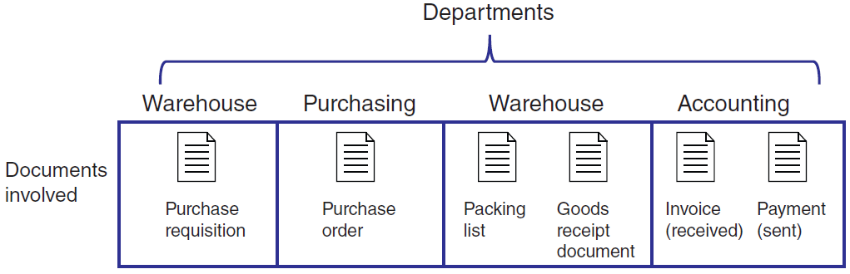
Departments & Documents Flow in Procurement

Slide 50
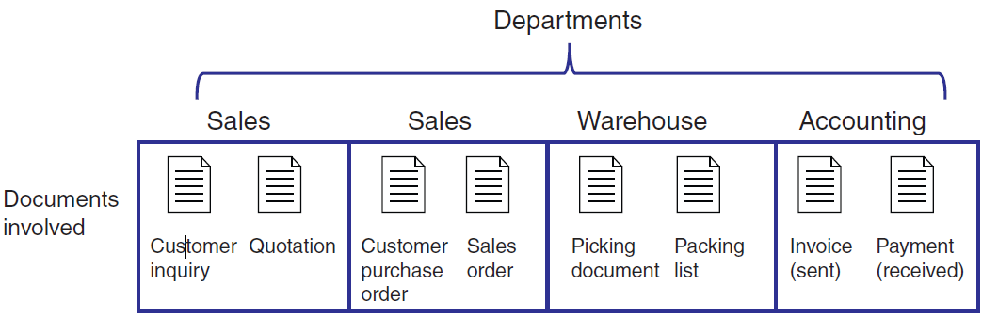
Departments & Documents Flow in Fulfillment

Slide 51
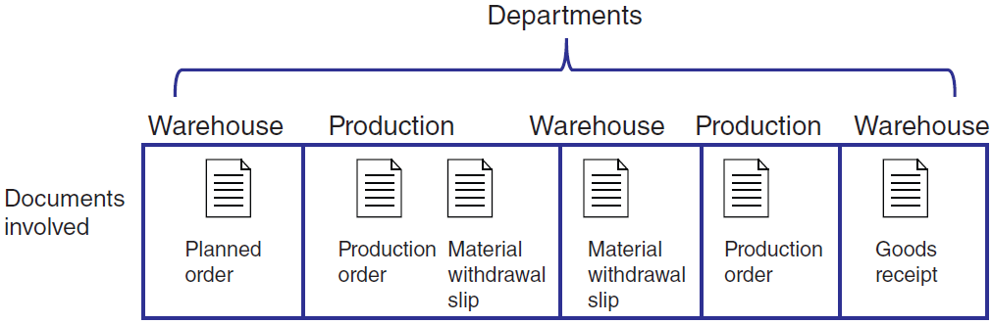
Departments & Documents Flow in Production

Slide 52
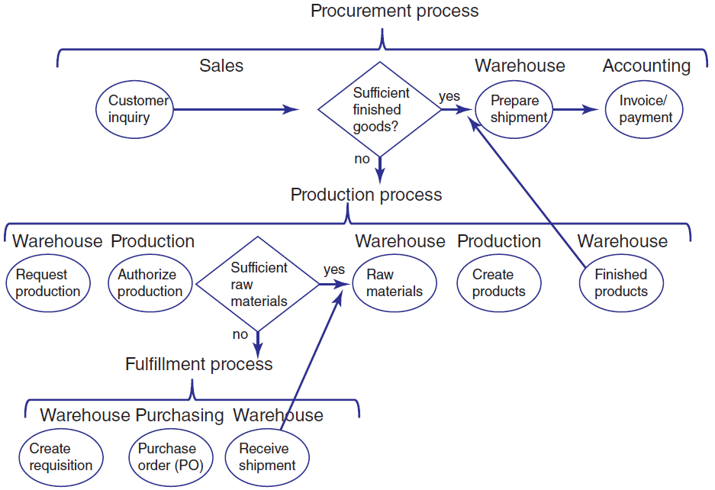
Integrated Processes with ERP Systems

Slide 53
Interorganizational Processes: ERP with SCM and CRM
SCM and CRM Processes: help multiple firms in an industry coordinate activities such as the production-to-sale of goods and services.
ERP SCM Systems: have the capability to place automatic requests to replenish raw materials/goods based on established criteria (e.g., below minimum quantity, expiration dates on perishable goods, etc.).
ERP CRM Systems: generate forecasting analyses of product consumption based on critical variables such as geographical area, season, day of the week, and type of customer; and, identify particular customer needs and then utilize this information to suggest specific product campaigns.
Notes:
SCM and CRM Processes: help multiple firms in an industry coordinate activities such as the production-to-sale of goods and services.
ERP SCM Systems: have the capability to place automatic requests to replinish raw materials/goods based on established criteria (e.g., below minimum quantity, expiration dates on perishable goods, etc.).
ERP CRM Systems: generate forecasting analyses of product consumption based on critical variables such as geographical area, season, day of the week, and type of customer; and, identify particular customer needs and then utilize this information to suggest specific product campaigns.

Slide 54
Interorganizational Processes: ERP with SCM and CRM
SCM and CRM Processes: help multiple firms in an industry coordinate activities such as the production-to-sale of goods and services.
ERP SCM Systems:
Place automatic requests to replenish raw materials/goods based on established criteria (e.g., below minimum quantity, expiration dates on perishable goods, etc.).
ERP CRM Systems:
forecasting of product consumption based on critical variables such as geographical area, season, day of the week, and type of customer; and, identify particular customer needs and then utilize this information to suggest specific product campaigns.
Notes:
SCM and CRM Processes: help multiple firms in an industry coordinate activities such as the production-to-sale of goods and services.
ERP SCM Systems: have the capability to place automatic requests to replinish raw materials/goods based on established criteria (e.g., below minimum quantity, expiration dates on perishable goods, etc.).
ERP CRM Systems: generate forecasting analyses of product consumption based on critical variables such as geographical area, season, day of the week, and type of customer; and, identify particular customer needs and then utilize this information to suggest specific product campaigns.

